Slide 1

NASA Pathways Internships
Illinois Space Grant Consortium

Slide 2
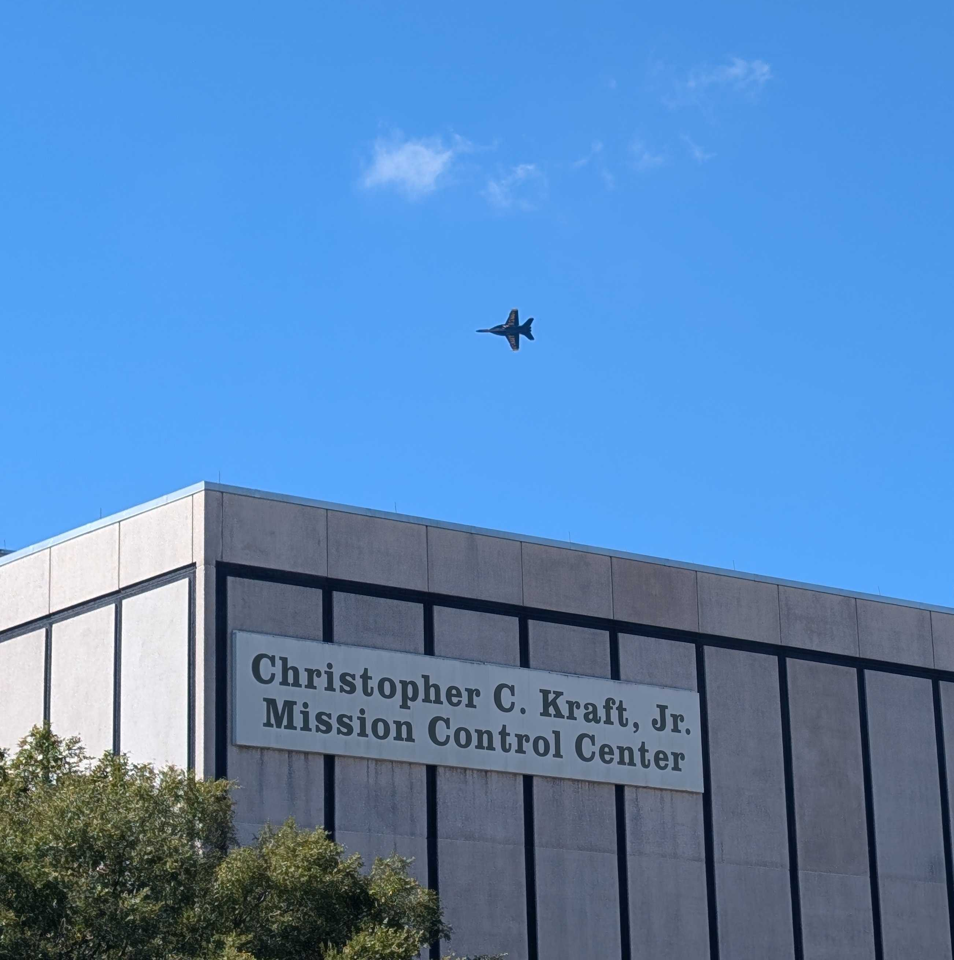
Agenda
OSTEM Vs Pathways
Application Process
What does NASA look for?
My Experience

Slide 3
OSTEM Vs. Pathways
OSTEM
PATHWAYS
One-time traditional internship experience.
Project Specific
Not Civil Servant
Focused on STEM majors
Full time job pipeline (minimum: 480 hours)
Varied Experiences and Branches
Civil Servant
Open to a variety of majors

Slide 4
Application Process
Create USA JOBS Profile
Create a Federal Resume
Pick NASA Centers
Application Assessment Questionnaire
USA Hire Assessments
Virtual Interview
Referral Notice
NASA
Internship!

Slide 5
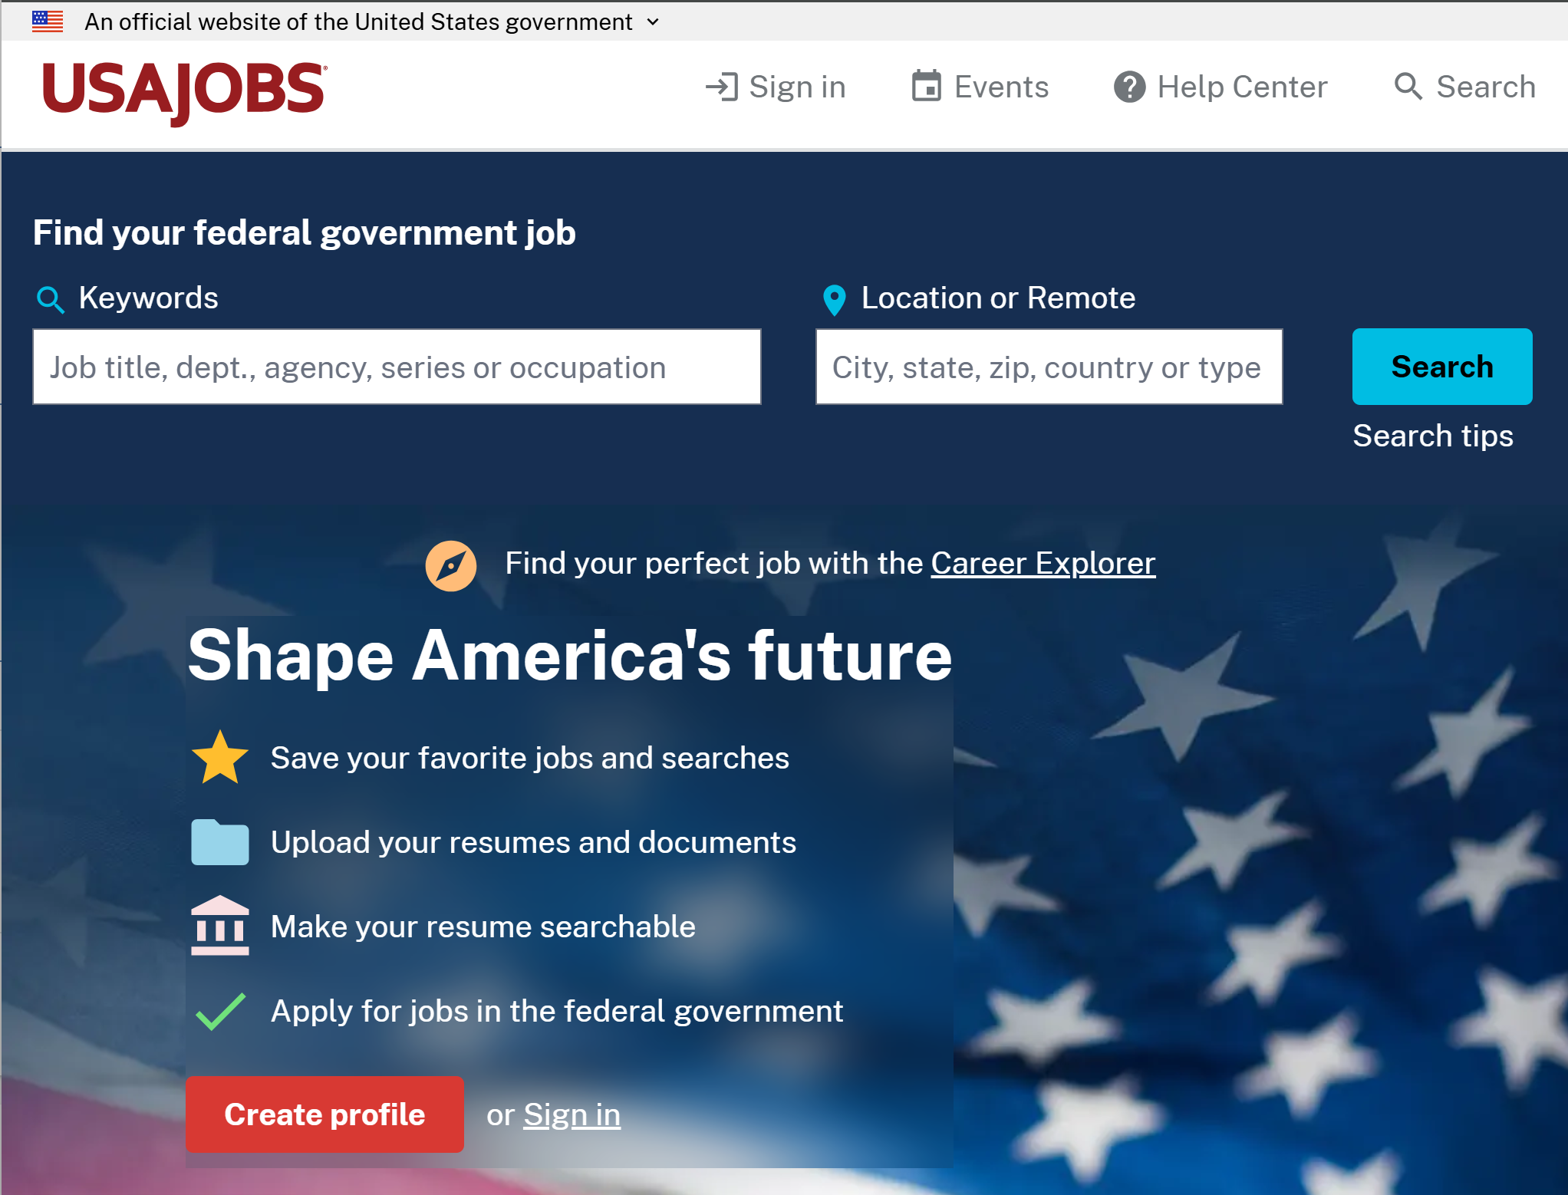
USA Jobs Profile
Profile
  Personal Information
  Work Experience
  Education
  Etc…
Application Periods:
  One week
  February-March → Fall
  August-September → Spring
  Spring 2026: Sept 22nd-26th
Notes:
You must start during a semester

Slide 6
Federal Resume
1-2 Pages
Narrative format, full sentence paragraphs.
A lot more details than a traditional resume
CAR Method
  Challenge
  Action
  Result
USA JOBS Resume builder or make your own
Tip: NASA cares less about how prestigious a student’s experiences are and more about how they contributed and demonstrated skills that align with NASA’s needs.

Slide 7
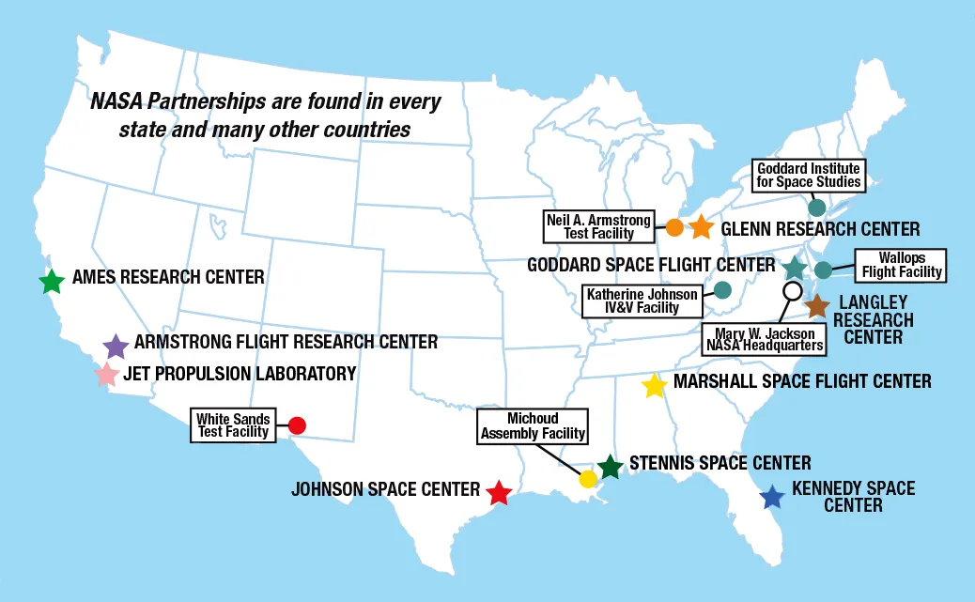
Pick NASA Centers
Notes:
Not all centers are available to all positions and in every cycle. The opening simply reflect NASAs hiring needs.

Slide 8




How to Pick a Center
Johnson Space Center
Armstrong Flight Research Center
NASA Headquarters
Houston, TX
Edwards, CA
Washington, DC
Home of human spaceflight. Mission Control and Astronaut training. Engineering, Sciences, Human Health.
Researched based in areas focused on Aviation, Aeronautics, and Flight testing.
Big decisions happen here. Provides overall guidance and direction for the Agency. Many non-STEM positions.
Tip: It is more important that the center students apply to aligns with their interests and experience rather than what they perceive to be a less/more competitive center.

Slide 9
Application Assessment Questionnaire
Requirements
Be a US Citizen.
Be at least 16 years of age.
Be enrolled in an accredited educational institution and maintain enrollment at least half time as defined by the institution.
Be pursuing a degree/certificate.
Be able to maintain at least a 2.9 GPA on a 4.0 scale.
Be able to complete at least 480 hours of work prior to completing your degree requirements (used to be 640 hours, but this was recently reduced to 480).
Be available to begin work the subsequent semester following the closing date of the vacancy for which you applied.
Types of Internships
Engineering, Science, and Technology
GS-899: Engineering
GS-1399: Physical Sciences
Business
GS-0099: Safety & Occupational Health
GS-199: Social Sciences
GS-299: Human Resources
GS-399: Administration and Program Management & Analysis
GS-599: Accounting & Budget
GS-1099: Communication & Public Relations
GS-1199: Procurement and Contracts
GS-1599: Math & Statistics
GS-2299: Information Technology
Notes:
NASA doesn’t just hire engineers they offer positions for a variety of majors. You are only competing against your own major.

Slide 10
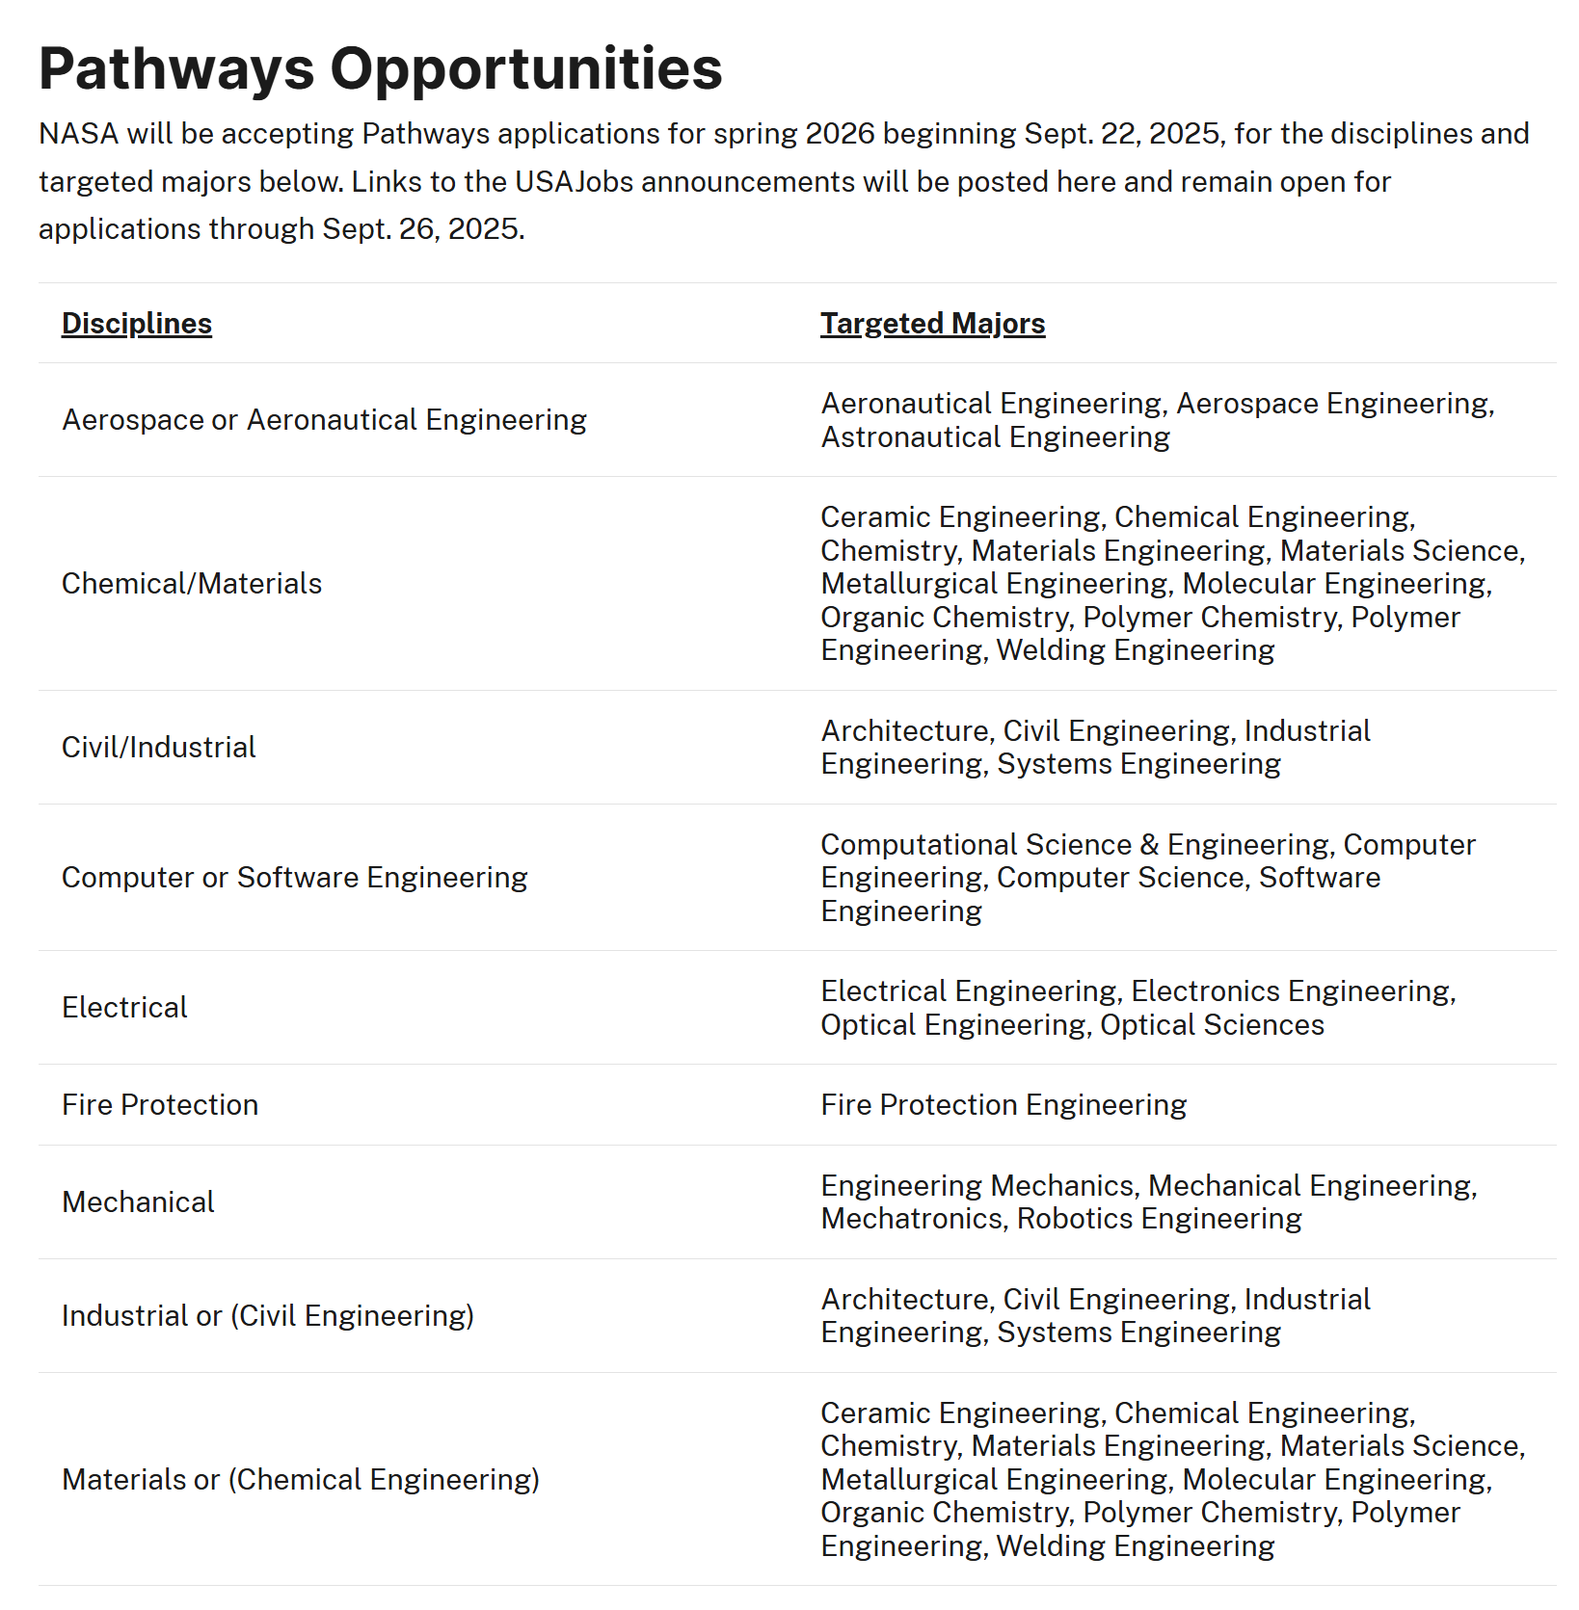
Spring 2026 Specifics
Due to budget constraints Pathways opportunities were limited for Spring 2026
Notes:
NASA doesn’t just hire engineers they offer positions for a variety of majors. You are only competing against your own major.

Slide 11
USA Hire Assessment
3 timed non-proctored test designed to test soft skills and desirable competencies.
Must be completed within 48 hours of job announcement closure.
Duration of 2-3 hours.
Results are stored for 1year.
Measure general competencies:
  Reasoning Skills
  Decision-Making Ability
  Reading Comprehension
  Soft Skills
    Interpersonal Skills
    Stress Tolerance
    Accountability

Slide 12
Referral
“Applicants who meet the NASA Pathways Program eligibility and qualification requirements and score in the best qualified category on the USA Hire assessments are forwarded to the hiring official for employment consideration.”
Tip: Students should take the time to complete the assessments to the best of their abilities. Referral ensures that a NASA official will take the time to look at the students resume.

Slide 13
Interview
Separate Interview for each center.
Conducted virtually through Microsoft Teams.
A Pathways program representative and a panel of NASA professionals ask a number of behavioral and situational questions.
This is NOT a technical interview.
25 – 45 minutes
Tip: Students should be prepared to answer questions using the CAR method and tie in relevant experiences from their resume.

Slide 14
What does NASA look for
Key Competencies:
Accountability
Attention to Detail
Customer Service
Decision Making
Flexibility
Integrity/Honesty
Interpersonal Skills
Learning
Reading
Self-Management (Achievement)
Stress Tolerance
Teamwork
“We’re looking for students who are not only captivated with the NASA vision & mission, but who are also well-rounded with diverse backgrounds, perspectives, and life experiences. If you enjoy working on teams and have a willingness to learn new things, we’re looking for you!”
– Nasa Pathways Internship Program Applicant Guide

Slide 15
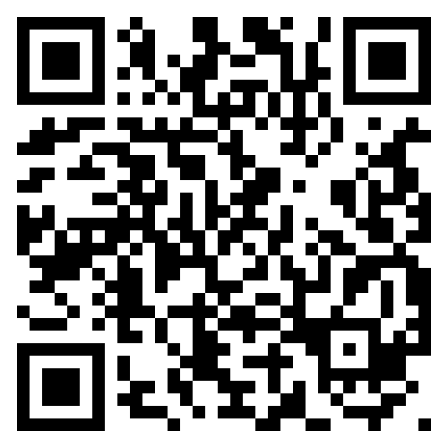
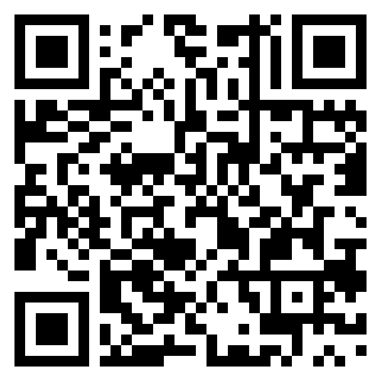
Additional Resources
NASA Pathways Website
NASA Centers

